Slide 1
Listening Skill+ IPA
Week -3

Slide 2
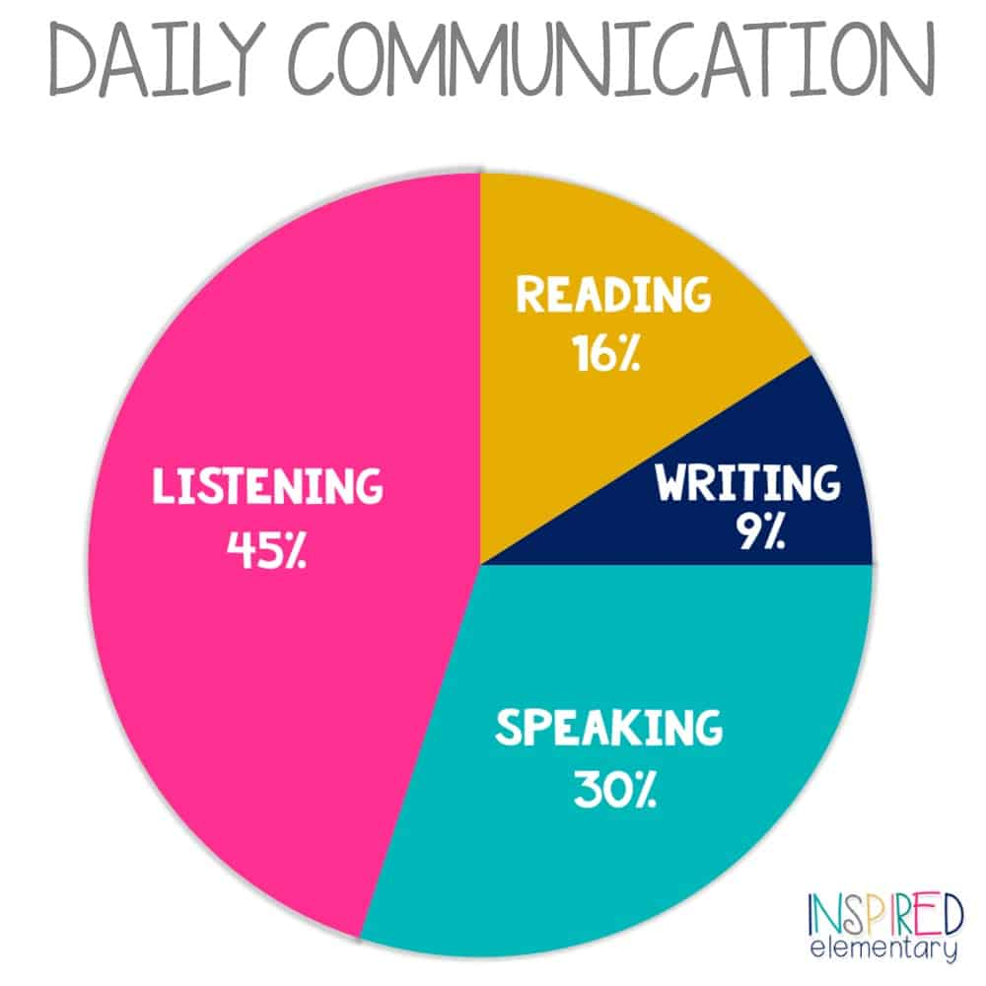

Slide 3


Slide 4
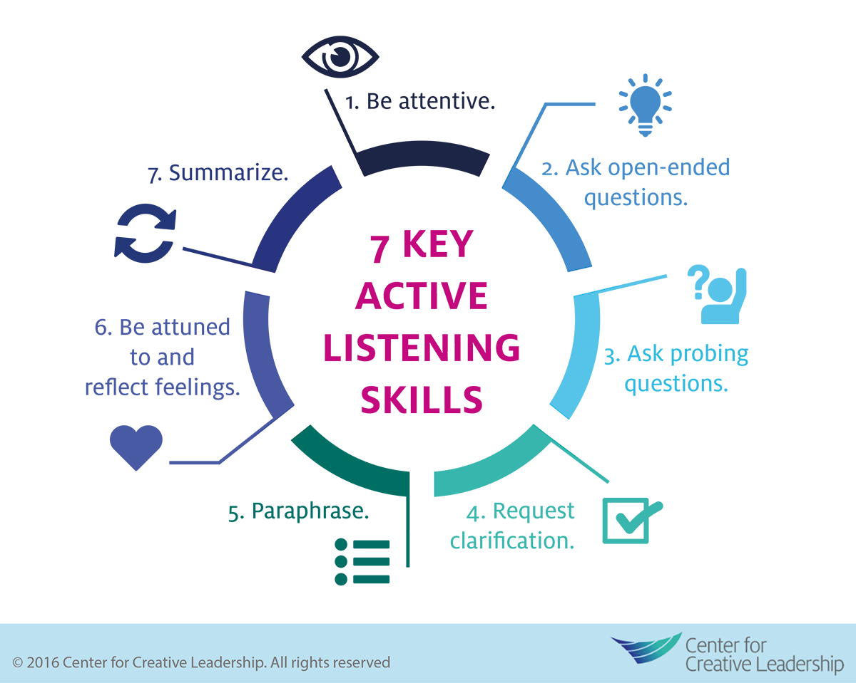

Slide 5
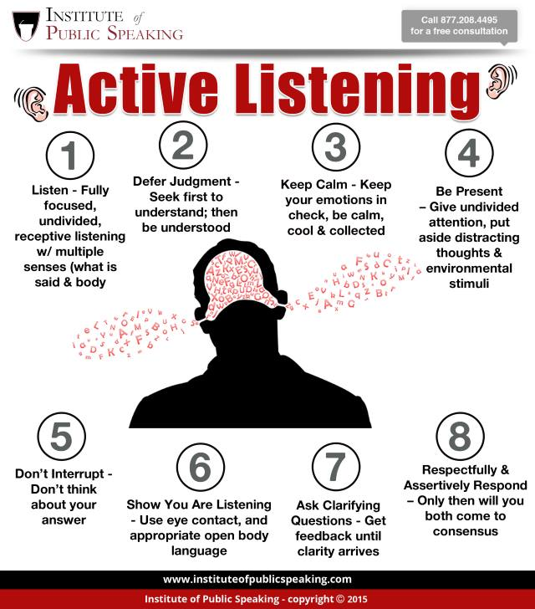

Slide 6
Activity 1
Listen to the Riddle

Slide 7
1.Which Room Is Safest?
A murderer is condemned to death. He has to choose between three rooms. The first is full of raging fires, the second is full of assassins with loaded guns, and the third is full of lions that haven’t eaten in three years. Which room is safest for him?

Slide 8
1.Which Room Is Safest?
A murderer is condemned to death. He has to choose between three rooms. The first is full of raging fires, the second is full of assassins with loaded guns, and the third is full of lions that haven’t eaten in three years. Which room is safest for him?
The third room. If the lions haven’t eaten in three years, they will be dead.

Slide 9
2. How Much Fruit?
A farmer in California owns a beautiful pear tree. He supplies the fruit to a nearby grocery store. The store owner has called the farmer to see how much fruit is available for him to purchase. The farmer knows that the main trunk has 24 branches. Each branch has exactly 12 boughs, and each bough has exactly six twigs. Since each twig bears one piece of fruit, how many plums will the farmer be able to deliver?

Slide 10
2. How Much Fruit?
A farmer in California owns a beautiful pear tree. He supplies the fruit to a nearby grocery store. The store owner has called the farmer to see how much fruit is available for him to purchase. The farmer knows that the main trunk has 24 branches. Each branch has exactly 12 boughs, and each bough has exactly six twigs. Since each twig bears one piece of fruit, how many plums will the farmer be able to deliver?
None, a pear tree does not bear plums.

Slide 11
3.
A man goes out for a walk during a storm with nothing to protect him from the rain. He doesn’t have a hat, a hood, or an umbrella. But by the end of his walk, there isn’t a single wet hair on his head. How can this be?

Slide 12
3.
A man goes out for a walk during a storm with nothing to protect him from the rain. He doesn’t have a hat, a hood, or an umbrella. But by the end of his walk, there isn’t a single wet hair on his head. How can this be?
He’s bald.

Slide 13
4.What word in the English language does the following:
the first two letters signify a male, the first three letters signify a female, the first four letters signify a demi-god, while the entire word signifies a great woman? What is the word?

Slide 14
4.What word in the English language does the following:
the first two letters signify a male, the first three letters signify a female, the first four letters signify a demi-god, while the entire word signifies a great woman? What is the word?
Heroine

Slide 15
5.Imagine you are a bus driver driving Westbound, and you have six passengers on board, then take these steps:Drive two blocks West, drop off half of the passengers, pick up five passengers, and then make a right.Travel 3 blocks, make a left, travel two more blocks, drop off 1/4 of the passengers, pick up three passengers, and then make two right turns.Travel 2 blocks, drop off 2/3 of the passengers, pick up one passenger, and then make a left.
What color are the bus driver’s eyes?

Slide 16
5.Imagine you are a bus driver driving Westbound, and you have six passengers on board, then take these steps:Drive two blocks West, drop off half of the passengers, pick up five passengers, and then make a right.Travel 3 blocks, make a left, travel two more blocks, drop off 1/4 of the passengers, pick up three passengers, and then make two right turns.Travel 2 blocks, drop off 2/3 of the passengers, pick up one passenger, and then make a left.
What color are the bus driver’s eyes?
You’re the driver, what color are your eyes?

Slide 17
6.
If 66=2, 999=3, 8=2, 0=1, 9696=4, 8123=2, 98=3, 88=4, then what does 816982 equal?

Slide 18
6.
If 66=2, 999=3, 8=2, 0=1, 9696=4, 8123=2, 98=3, 88=4, then what does 816982 equal?
6, simply count the number of circles in each set of numbers.

Slide 19

IPA Symbols

Slide 20
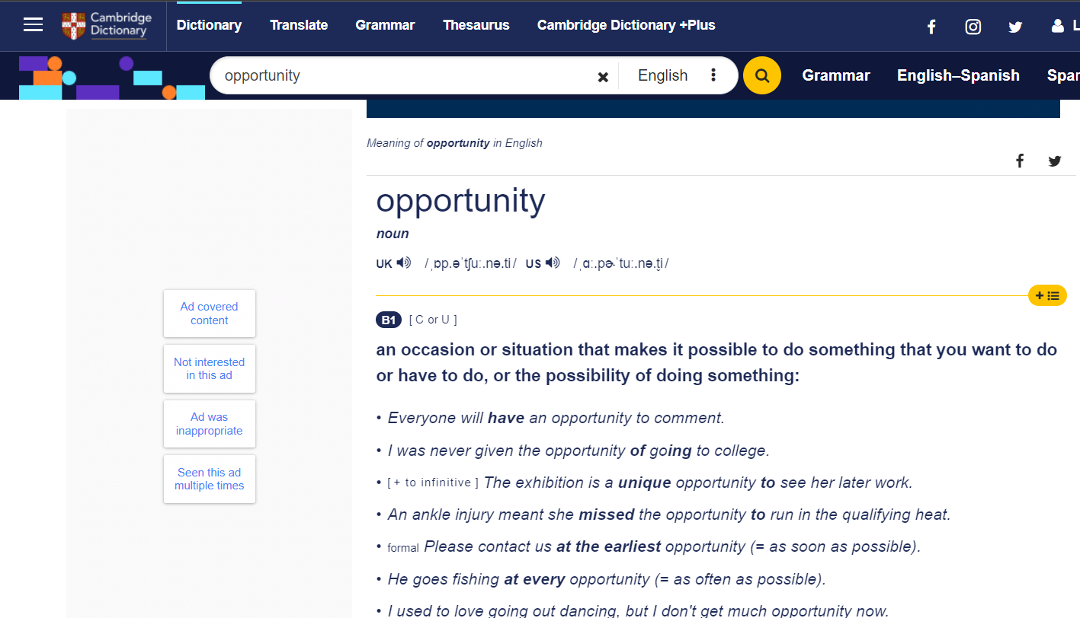

Slide 21


Slide 22


